Slide 1
Chapter 4
Nouman M Durrani

Slide 2
Data Transfer Instructions
Operand Types
x86 instruction formats:
[label:] mnemonic [operands][ ; comment ]
Because the number of operands may vary, we can further subdivide the formats to have zero,
one, two, or three operands. Here, we omit the label and comment fields for clarity:
mnemonic
mnemonic [ destination]
mnemonic [ destination],[source]
mnemonic [destination],[source-1],[source-2]
To give added flexibility to the instruction set, x86 assembly language uses different types of instruction operands. The following are the easiest to use:
• Immediate—uses a numeric literal expression
•Register—uses a named register in the CPU
• Memory—references a memory location

Slide 3
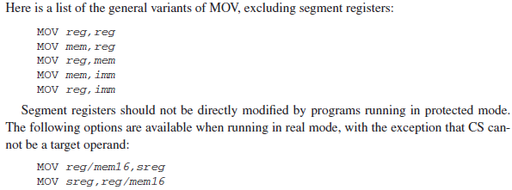
MOV Instruction
The MOV instruction copies data from a source operand to a destination operand.
Its basic format shows that the first operand is the destination and the second operand is the source:
MOV destination, source

Slide 4

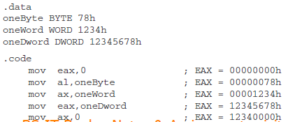
Overlapping Values:

Slide 5



Solution:

Slide 6


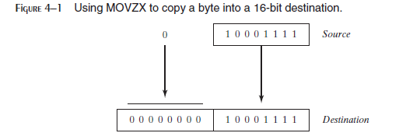

Slide 7
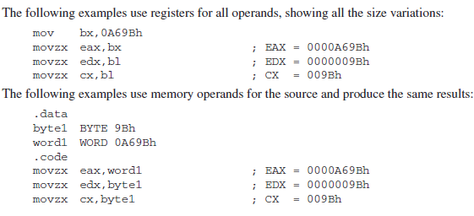


Slide 8



Slide 9
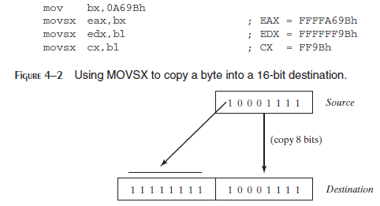

Slide 10
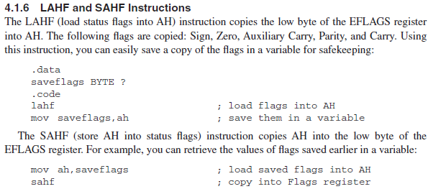

Slide 11

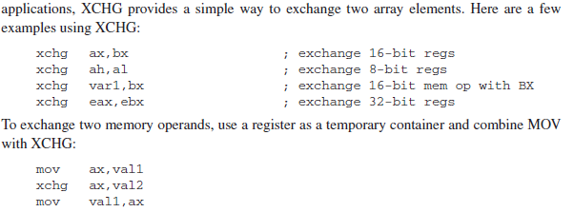

Slide 12
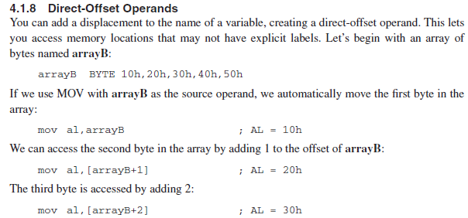


Slide 13

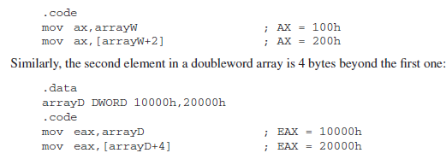

Slide 14
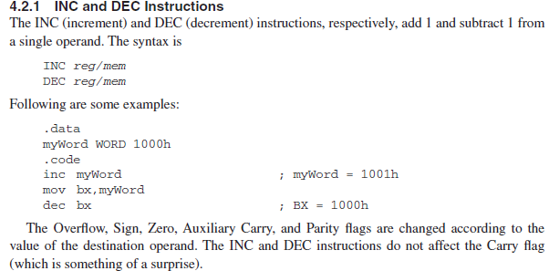

Slide 15
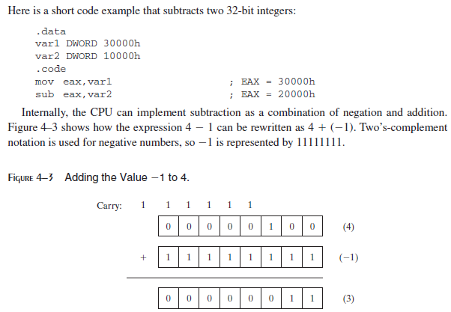

Slide 16

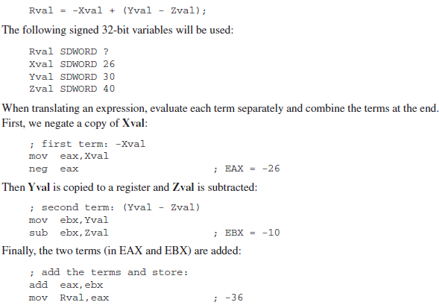

Slide 17
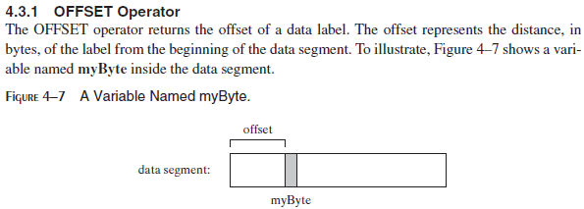
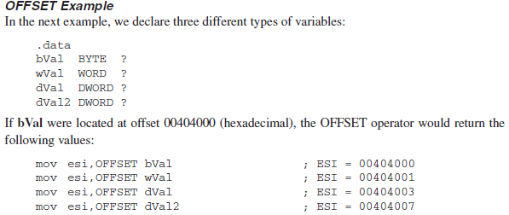

Slide 18
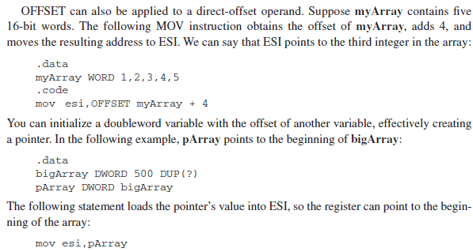

Slide 19
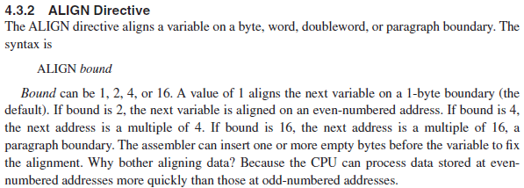


Slide 20
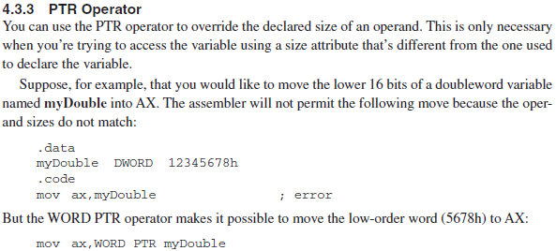


Slide 21
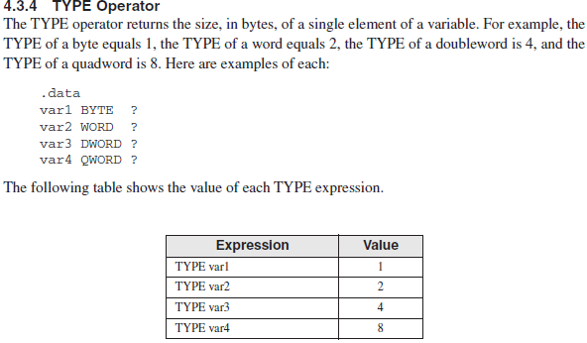

Slide 22



Slide 23


Slide 24
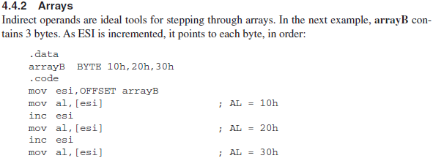

Slide 25
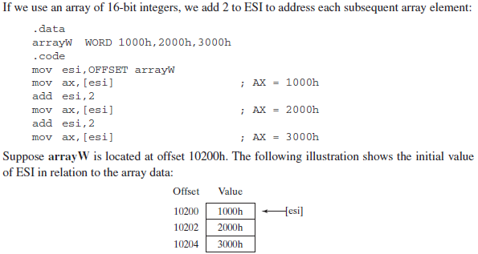

Slide 26
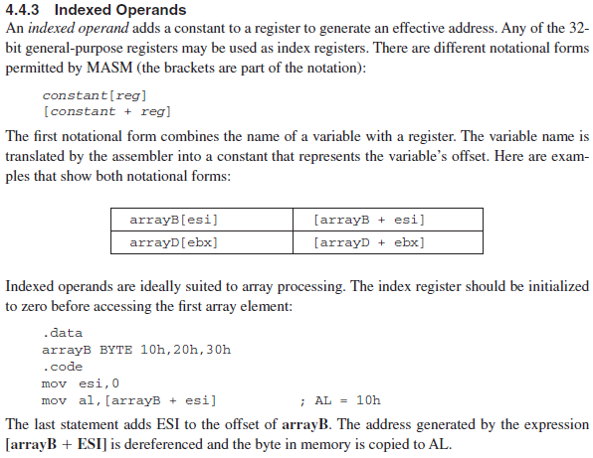

Slide 27
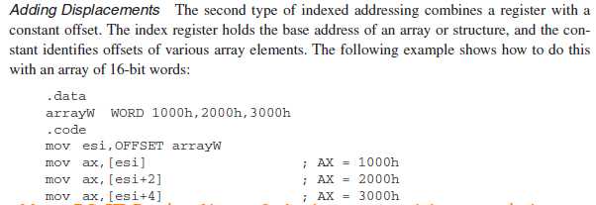


Slide 28


